Slide 1
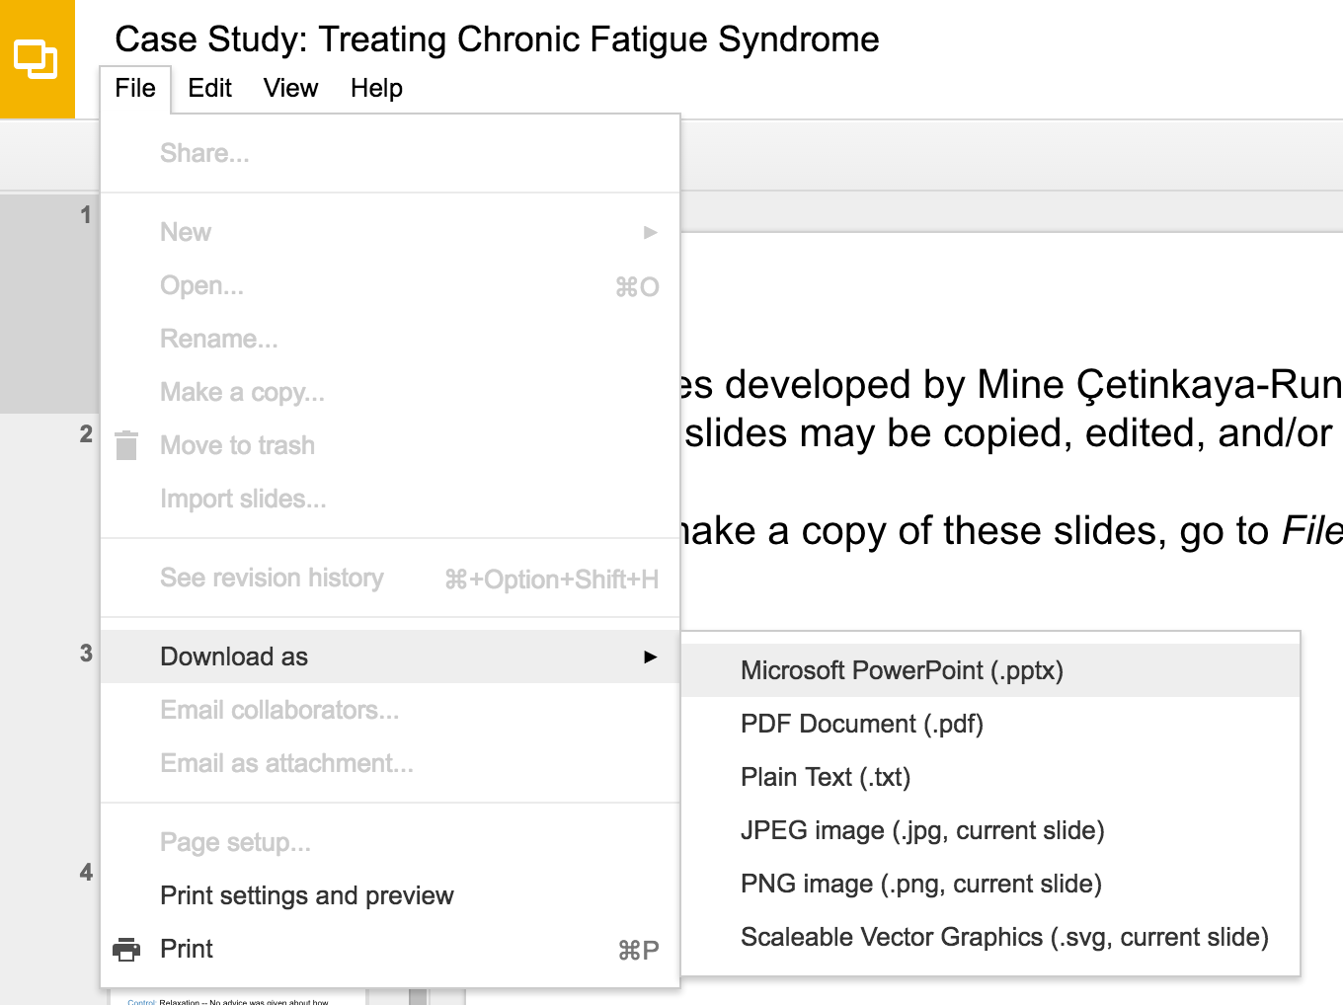
Slides developed by Mine Çetinkaya-Rundel of OpenIntro
Translated from LaTeX to Google Slides by Curry W. Hilton of OpenIntro.
The slides may be copied, edited, and/or shared via the CC BY-SA license
To make a copy of these slides, go to File > Download as > [option], as shown below. Or if you are logged into a Google account, you can choose Make a copy... to create your own version in Google Drive.

Slide 2
Binomial distribution

Slide 3
Suppose we randomly select four individuals to participate in this experiment. What is the probability that exactly 1 of them will refuse to administer the shock?

Slide 4
Suppose we randomly select four individuals to participate in this experiment. What is the probability that exactly 1 of them will refuse to administer the shock?
Let's call these people Allen (A), Brittany (B), Caroline (C), and Damian (D). Each one of the four scenarios below will satisfy the condition of “exactly 1 of them refuses to administer the shock”:

Slide 5
Suppose we randomly select four individuals to participate in this experiment. What is the probability that exactly 1 of them will refuse to administer the shock?
Let's call these people Allen (A), Brittany (B), Caroline (C), and Damian (D). Each one of the four scenarios below will satisfy the condition of “exactly 1 of them refuses to administer the shock”:

Slide 6
Suppose we randomly select four individuals to participate in this experiment. What is the probability that exactly 1 of them will refuse to administer the shock?
Let's call these people Allen (A), Brittany (B), Caroline (C), and Damian (D). Each one of the four scenarios below will satisfy the condition of “exactly 1 of them refuses to administer the shock”:

Slide 7
Suppose we randomly select four individuals to participate in this experiment. What is the probability that exactly 1 of them will refuse to administer the shock?
Let's call these people Allen (A), Brittany (B), Caroline (C), and Damian (D). Each one of the four scenarios below will satisfy the condition of “exactly 1 of them refuses to administer the shock”:

Slide 8
Suppose we randomly select four individuals to participate in this experiment. What is the probability that exactly 1 of them will refuse to administer the shock?
Let's call these people Allen (A), Brittany (B), Caroline (C), and Damian (D). Each one of the four scenarios below will satisfy the condition of “exactly 1 of them refuses to administer the shock”:

Slide 9
Suppose we randomly select four individuals to participate in this experiment. What is the probability that exactly 1 of them will refuse to administer the shock?
Let's call these people Allen (A), Brittany (B), Caroline (C), and Damian (D). Each one of the four scenarios below will satisfy the condition of “exactly 1 of them refuses to administer the shock”:
The probability of exactly one 1 of 4 people refusing to administer the shock is the sum of all of these probabilities.

Slide 10
Binomial distribution
The question from the prior slide asked for the probability of given number of successes, k, in a given number of trials, n, (k = 1 success in n = 4 trials), and we calculated this probability as
# of scenarios x P(single scenario)

Slide 11
Binomial distribution
The question from the prior slide asked for the probability of given number of successes, k, in a given number of trials, n, (k = 1 success in n = 4 trials), and we calculated this probability as
# of scenarios x P(single scenario)
# of scenarios: there is a less tedious way to figure this out, we'll get to that shortly...

Slide 12
Binomial distribution
The question from the prior slide asked for the probability of given number of successes, k, in a given number of trials, n, (k = 1 success in n = 4 trials), and we calculated this probability as
# of scenarios x P(single scenario)
# of scenarios: there is a less tedious way to figure this out, we'll get to that shortly...
P(single scenario) = p^{k}(1-p)^{n-k} where p is the probability of success to the power of number of successes, probability of failure to the power of number of failures

Slide 13
Binomial distribution
The question from the prior slide asked for the probability of given number of successes, k, in a given number of trials, n, (k = 1 success in n = 4 trials), and we calculated this probability as
# of scenarios x P(single scenario)
# of scenarios: there is a less tedious way to figure this out, we'll get to that shortly...
P(single scenario) = p^{k}(1-p)^{n-k} where p is the probability of success to the power of number of successes, probability of failure to the power of number of failures
The Binomial distribution describes the probability of having exactly k successes in n independent Bernoulli trials with probability of success p.

Slide 14
Computing the # of scenarios
Earlier we wrote out all possible scenarios that fit the condition of exactly one person refusing to administer the shock. If n was larger and/or k was different than 1, for example, n = 9 and k = 2:

Slide 15

Computing the # of scenarios
Earlier we wrote out all possible scenarios that fit the condition of exactly one person refusing to administer the shock. If n was larger and/or k was different than 1, for example, n = 9 and k = 2:

Slide 16

Computing the # of scenarios
Earlier we wrote out all possible scenarios that fit the condition of exactly one person refusing to administer the shock. If n was larger and/or k was different than 1, for example, n = 9 and k = 2:

Slide 17
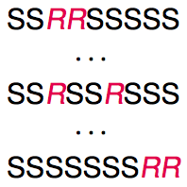
Computing the # of scenarios
Earlier we wrote out all possible scenarios that fit the condition of exactly one person refusing to administer the shock. If n was larger and/or k was different than 1, for example, n = 9 and k = 2:
writing out all possible scenarios would be incredibly tedious and prone to errors.

Slide 18

Computing the # of scenarios
Choose function
The choose function is useful for calculating the number of ways to choose k successes in n trials.

Slide 19

Computing the # of scenarios
Choose function
The choose function is useful for calculating the number of ways to choose k successes in n trials.

Slide 20
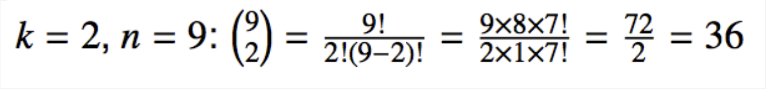
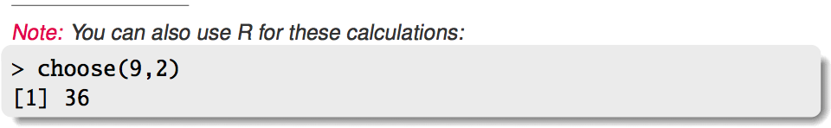
Computing the # of scenarios
Choose function
The choose function is useful for calculating the number of ways to choose k successes in n trials.

Slide 21
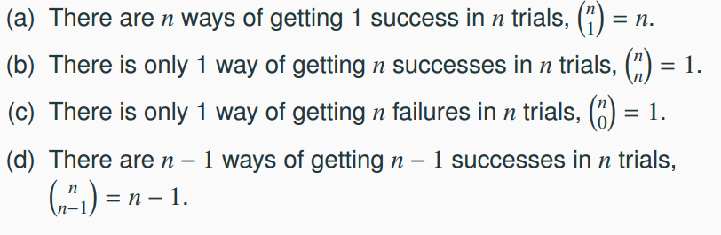
Practice
Which of the following is false?

Slide 22
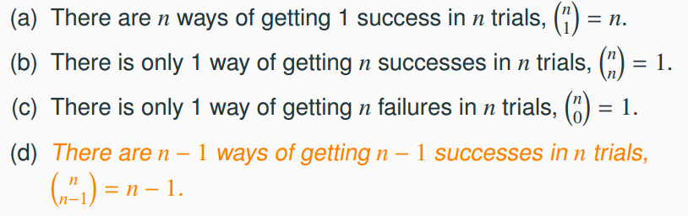
Practice
Which of the following is false?

Slide 23
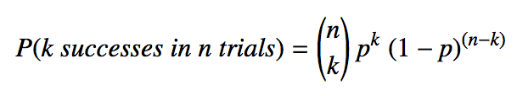
Binomial distribution (cont.)
Binomial probabilities
If p represents probability of success, (1-p) represents probability of failure, n represents number of independent trials, and k represents number of successes

Slide 24
Practice
Which of the following is not a condition that needs to be met for the binomial distribution to be applicable?
the trials must be independent
the number of trials, n, must be fixed
each trial outcome must be classified as a success or a failure
the number of desired successes, k, must be greater than the number of trials
the probability of success, p, must be the same for each trial

Slide 25
Practice
Which of the following is not a condition that needs to be met for the binomial distribution to be applicable?
the trials must be independent
the number of trials, n, must be fixed
each trial outcome must be classified as a success or a failure
the number of desired successes, k, must be greater than the number of trials
the probability of success, p, must be the same for each trial

Slide 26
Practice
A 2012 Gallup survey suggests that 26.2% of Americans are obese. Among a random sample of 10 Americans, what is the probability that exactly 8 are obese?
pretty high
pretty low
Gallup: http://www.gallup.com/poll/160061/obesity-rate-stable-2012.aspx, January 23, 2013.

Slide 27
Practice
A 2012 Gallup survey suggests that 26.2% of Americans are obese. Among a random sample of 10 Americans, what is the probability that exactly 8 are obese?
pretty high
pretty low
Gallup: http://www.gallup.com/poll/160061/obesity-rate-stable-2012.aspx, January 23, 2013.

Slide 28
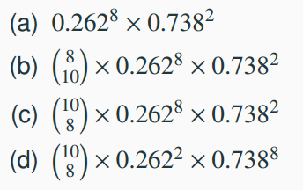
Practice
A 2012 Gallup survey suggests that 26.2% of Americans are obese. Among a random sample of 10 Americans, what is the probability that exactly 8 are obese?

Slide 29
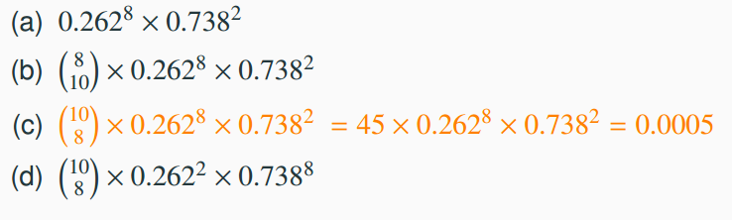
Practice
A 2012 Gallup survey suggests that 26.2% of Americans are obese. Among a random sample of 10 Americans, what is the probability that exactly 8 are obese?

Slide 30
The birthday problem
What is the probability that 2 randomly chosen people share a birthday?

Slide 31
The birthday problem
What is the probability that 2 randomly chosen people share a birthday?
Pretty low, 1 / 365 ≈ 0.0027

Slide 32
The birthday problem
What is the probability that 2 randomly chosen people share a birthday?
Pretty low, 1 / 365 ≈ 0.0027
What is the probability that at least 2 people out of 366 people share a birthday?

Slide 33
The birthday problem
What is the probability that 2 randomly chosen people share a birthday?
Pretty low, 1 / 365 ≈ 0.0027
What is the probability that at least 2 people out of 366 people share a birthday?
Exactly 1! (Excluding the possibility of a leap year birthday.)

Slide 34
The birthday problem (cont.)
What is the probability that at least 2 people (1 match) out of 121 people share a birthday?

Slide 35

The birthday problem (cont.)
What is the probability that at least 2 people (1 match) out of 121 people share a birthday?
Somewhat complicated to calculate, but we can think of it as the complement of the probability that there are no matches in 121 people.

Slide 36

The birthday problem (cont.)
What is the probability that at least 2 people (1 match) out of 121 people share a birthday?
Somewhat complicated to calculate, but we can think of it as the complement of the probability that there are no matches in 121 people.

Slide 37

The birthday problem (cont.)
What is the probability that at least 2 people (1 match) out of 121 people share a birthday?
Somewhat complicated to calculate, but we can think of it as the complement of the probability that there are no matches in 121 people.

Slide 38
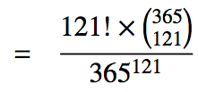
The birthday problem (cont.)
What is the probability that at least 2 people (1 match) out of 121 people share a birthday?
Somewhat complicated to calculate, but we can think of it as the complement of the probability that there are no matches in 121 people.

Slide 39
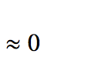
The birthday problem (cont.)
What is the probability that at least 2 people (1 match) out of 121 people share a birthday?
Somewhat complicated to calculate, but we can think of it as the complement of the probability that there are no matches in 121 people.

Slide 40

The birthday problem (cont.)
What is the probability that at least 2 people (1 match) out of 121 people share a birthday?
Somewhat complicated to calculate, but we can think of it as the complement of the probability that there are no matches in 121 people.

Slide 41
Expected value
A 2012 Gallup survey suggests that 26.2% of Americans are obese.
Among a random sample of 100 Americans, how many would you expect to be obese?

Slide 42
Expected value
A 2012 Gallup survey suggests that 26.2% of Americans are obese.
Among a random sample of 100 Americans, how many would you expect to be obese?
Easy enough, 100 x 0.262 = 26.2.

Slide 43
Expected value
A 2012 Gallup survey suggests that 26.2% of Americans are obese.
Among a random sample of 100 Americans, how many would you expect to be obese?
Easy enough, 100 x 0.262 = 26.2.
Or more formally, µ = np = 100 x 0.262 = 26.2.

Slide 44
Expected value
A 2012 Gallup survey suggests that 26.2% of Americans are obese.
Among a random sample of 100 Americans, how many would you expect to be obese?
Easy enough, 100 x 0.262 = 26.2.
Or more formally, µ = np = 100 x 0.262 = 26.2.
But this doesn't mean in every random sample of 100 people exactly 26.2 will be obese. In fact, that's not even possible. In some samples this value will be less, and in others more. How much would we expect this value to vary?

Slide 45

Expected value and its variability
Mean and standard deviation of binomial distribution

Slide 46

Expected value and its variability
Mean and standard deviation of binomial distribution
Going back to the obesity rate:

Slide 47
Expected value and its variability
Mean and standard deviation of binomial distribution
Going back to the obesity rate:
We would expect 26.2 out of 100 randomly sampled Americans to be obese, with a standard deviation of 4.4.
_________
Note: Mean and standard deviation of a binomial might not always be whole numbers, and that is alright, these values represent what we would expect to see on average.

Slide 48
Unusual observations
Using the notion that observations that are more than 2 standard deviations away from the mean are considered unusual and the mean and the standard deviation we just computed, we can calculate a range for the plausible number of obese Americans in random samples of 100.
26.2 ± (2 x 4.4) → (17.4, 35.0)

Slide 49
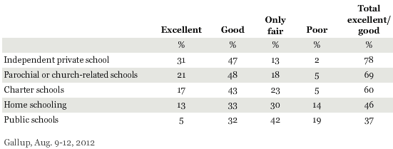
Practice
An August 2012 Gallup poll suggests that 13% of Americans think home schooling provides an excellent education for children. Would a random sample of 1,000 Americans where only 100 share this opinion be considered unusual?
(a) Yes (b) No
http://www.gallup.com/poll/156974/private-schools-top-marks-educating-children.aspx

Slide 50

Practice
An August 2012 Gallup poll suggests that 13% of Americans think home schooling provides an excellent education for children. Would a random sample of 1,000 Americans where only 100 share this opinion be considered unusual?
(a) Yes (b) No
http://www.gallup.com/poll/156974/private-schools-top-marks-educating-children.aspx

Slide 51
Practice
An August 2012 Gallup poll suggests that 13% of Americans think home schooling provides an excellent education for children. Would a random sample of 1,000 Americans where only 100 share this opinion be considered unusual?
(a) Yes (b) No
http://www.gallup.com/poll/156974/private-schools-top-marks-educating-children.aspx

Slide 52
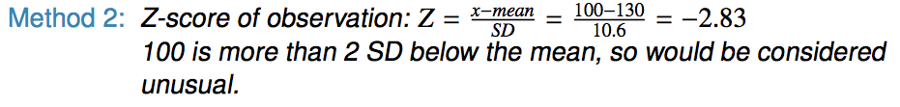
Practice
An August 2012 Gallup poll suggests that 13% of Americans think home schooling provides an excellent education for children. Would a random sample of 1,000 Americans where only 100 share this opinion be considered unusual?
(a) Yes (b) No
http://www.gallup.com/poll/156974/private-schools-top-marks-educating-children.aspx

Slide 53
Shapes of binomial distributions
For this activity you will use a web applet. Go to http://socr.stat.ucla.edu/htmls/SOCR_Experiments.html and choose Binomial coin experiment in the drop down menu on the left.
Set the number of trials to 20 and the probability of success to 0.15. Describe the shape of the distribution of number of successes.
Keeping p constant at 0.15, determine the minimum sample size required to obtain a unimodal and symmetric distribution of number of successes. Please submit only one response per team.
Further considerations:
What happens to the shape of the distribution as n stays constant and p changes?
What happens to the shape of the distribution as p stays constant and n changes?

Slide 54
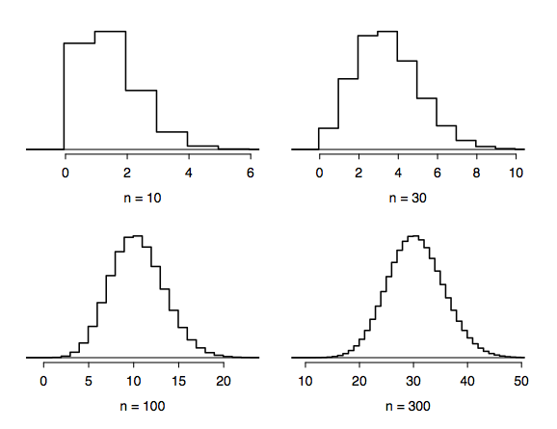
Distributions of number
of successes
Hollow histograms of samples from the binomial model where p = 0.10 and n = 10, 30, 100, and 300. What happens as n increases?

Slide 55
Low large is large enough?
The sample size is considered large enough if the expected number of successes and failures are both at least 10.
np ≥ 10 and n(1 - p) ≥ 10

Slide 56
Low large is large enough?
The sample size is considered large enough if the expected number of successes and failures are both at least 10.
np ≥ 10 and n(1 - p) ≥ 10
10 x 0.13 ≈ 1.3
10 x (1 - 0.13) = 8.7

Slide 57
Practice
Below are four pairs of Binomial distribution parameters. Which distribution can be approximated by the normal distribution?
n = 100, p = 0.95
n = 25, p = 0.45
n = 150, p = 0.05
n = 500, p = 0.015
Below are four pairs of Binomial distribution parameters. Which distribution can be approximated by the normal distribution?
n = 100, p = 0.95
n = 25, p = 0.45
n = 150, p = 0.05
n = 500, p = 0.015

Slide 58
Practice
Below are four pairs of Binomial distribution parameters. Which distribution can be approximated by the normal distribution?
n = 100, p = 0.95
n = 25, p = 0.45
n = 150, p = 0.05
n = 500, p = 0.015
Below are four pairs of Binomial distribution parameters. Which distribution can be approximated by the normal distribution?
n = 100, p = 0.95
n = 25, p = 0.45 → 25 x 0.45 = 11.25, 25 x 0.55 = 13.75
n = 150, p = 0.05
n = 500, p = 0.015

Slide 59
An analysis of Facebook users
A recent study found that “Facebook users get more than they give”. For example:
40% of Facebook users in our sample made a friend request, but 63% received at least one request
Users in our sample pressed the like button next to friends' content an average of 14 times, but had their content ``liked" an average of 20 times
Users sent 9 personal messages, but received 12
12% of users tagged a friend in a photo, but 35% were themselves tagged in a photo
Any guesses for how this pattern can be explained?
http://www.pewinternet.org/Reports/2012/Facebook-users/Summary.aspx

Slide 60
An analysis of Facebook users
A recent study found that “Facebook users get more than they give”. For example:
40% of Facebook users in our sample made a friend request, but 63% received at least one request
Users in our sample pressed the like button next to friends' content an average of 14 times, but had their content ``liked" an average of 20 times
Users sent 9 personal messages, but received 12
12% of users tagged a friend in a photo, but 35% were themselves tagged in a photo
Any guesses for how this pattern can be explained?
Power users contribute much more content than the typical user.
http://www.pewinternet.org/Reports/2012/Facebook-users/Summary.aspx

Slide 61
Practice
This study also found that approximately 25% of Facebook users are considered power users. The same study found that the average Facebook user has 245 friends. What is the probability that the average Facebook user with 245 friends has 70 or more friends who would be considered power users? Note any assumptions you must make.
We are given that n = 245, p = 0.25, and we are asked for the probability P(K ≥70). To proceed, we need independence, which we'll assume but could check if we had access to more Facebook data.

Slide 62
Practice
This study also found that approximately 25% of Facebook users are considered power users. The same study found that the average Facebook user has 245 friends. What is the probability that the average Facebook user with 245 friends has 70 or more friends who would be considered power users? Note any assumptions you must make.
We are given that n = 245, p = 0.25, and we are asked for the probability P(K ≥70). To proceed, we need independence, which we'll assume but could check if we had access to more Facebook data.
P(X ≥ 70) = P(K = 70 or K = 71 or K = 72 or … or K = 245) = P(K = 70) + P(K = 71) + P(K = 72) + … + P(K = 245)

Slide 63
Practice
This study also found that approximately 25% of Facebook users are considered power users. The same study found that the average Facebook user has 245 friends. What is the probability that the average Facebook user with 245 friends has 70 or more friends who would be considered power users? Note any assumptions you must make.
We are given that n = 245, p = 0.25, and we are asked for the probability P(K ≥70). To proceed, we need independence, which we'll assume but could check if we had access to more Facebook data.
P(X ≥ 70) = P(K = 70 or K = 71 or K = 72 or … or K = 245) = P(K = 70) + P(K = 71) + P(K = 72) + … + P(K = 245)
This seems like an awful lot of work...

Slide 64
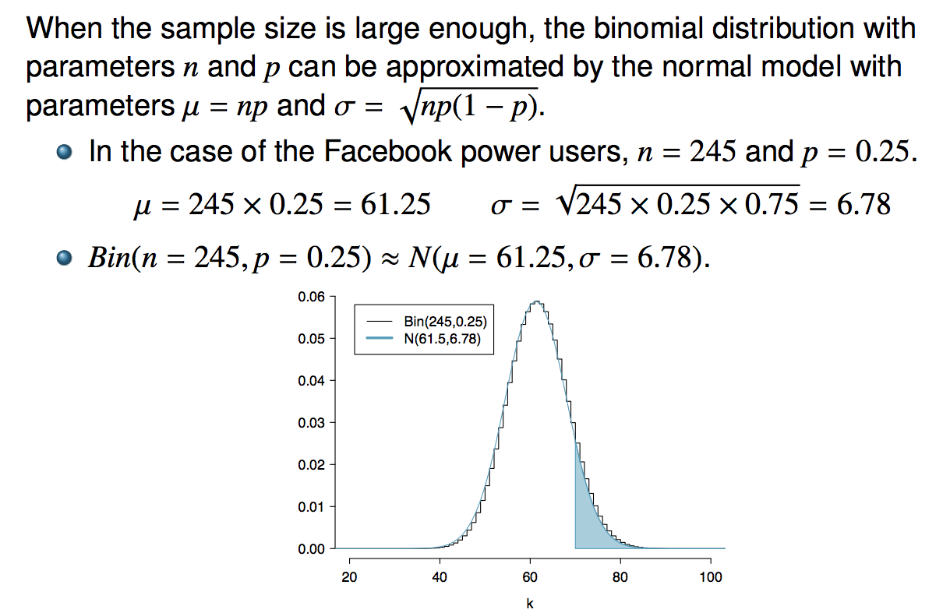
Normal approximation
to the binomial

Slide 65
Practice
What is the probability that the average Facebook user with 245 friends has 70 or more friends who would be considered power users?

Slide 66
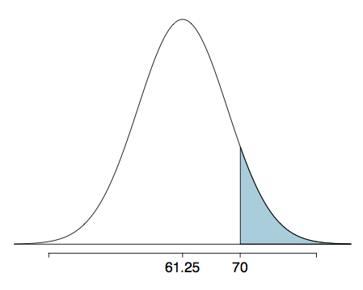
Practice
What is the probability that the average Facebook user with 245 friends has 70 or more friends who would be considered power users?

Slide 67
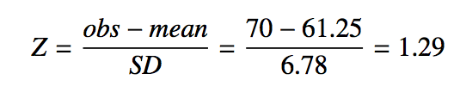
Practice
What is the probability that the average Facebook user with 245 friends has 70 or more friends who would be considered power users?

Slide 68
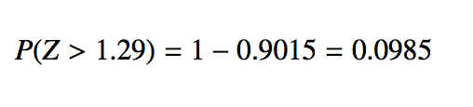
Practice
What is the probability that the average Facebook user with 245 friends has 70 or more friends who would be considered power users?

Slide 69
The normal approximation breaks down on small intervals
The normal approximation to the binomial distribution tends to perform poorly when estimating the probability of a small range of counts, even when the conditions are met.
This approximation for intervals of values is usually improved if cutoff values are extended by 0.5 in both directions.
The tip to add extra area when applying the normal approximation is most often useful when examining a range of observations. While it is possible to also apply this correction when computing a tail area, the benefit of the modification usually disappears since the total interval is typically quite wide.

Slide 70
Find more resources at openintro.org/os, including
Slides
Videos
Statistical Software Labs
Discussion Forums (free support for students and teachers)
Learning Objectives
Teachers only content is also available for Verified Teachers, including
Exercise solutions
Sample exams
Ability to request a free desk copy for a course
Statistics Teachers email group
Questions? Contact us.

Slide 71
Appendix
Probability Tables

Slide 72
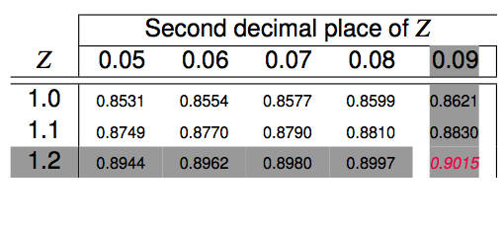
Practice
What is the probability that the average Facebook user with 245 friends has 70 or more friends who would be considered power users?

Slide 73
Practice
What is the probability that the average Facebook user with 245 friends has 70 or more friends who would be considered power users?

